Slide 1

ER Model to Relational Schema

Slide 2
N
Fname
Mname
Lname
Location
Works for
Name
Addres
1
Bdate
N
Dname
Dnum
Salary
Ssn
Department
No_of_employee
Employee
1
Start_date
1
Manages
Controls
1
1
Dependents of
Hours
Works on
N
Supervision
1
N
Project
M
N
N
Dependent
Pname
location
Pnumber
DepName
Relationship
Sex
Bdate

Slide 3
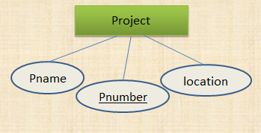
ER to Relational schema (Strong Entity)
Project ( Pnumber, Pname, location )

Slide 4
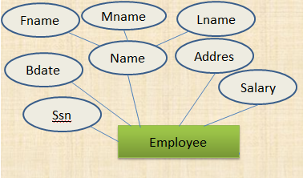
ER to Relational schema (Composite Attribute)
Employee ( Ssn, Bdate, Fname, Mname, Lname, Address, salary )

Slide 5
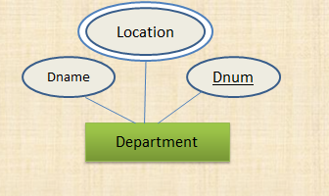
ER to Relational schema (Multivalued Attribute)
Department ( Dname, Dnum )
Dept_location ( Dnum, location )
Dept_Phone (

Slide 6
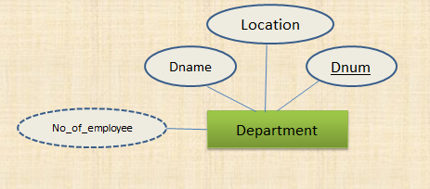
ER to Relational schema (Derived Attribute)
Department ( Dname, Dnum, location )

Slide 7
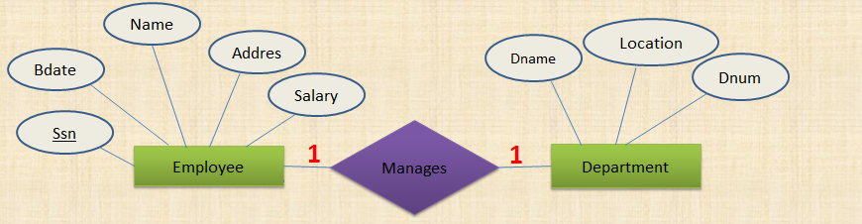
ER to Relational schema (1 to 1 relation)
Employee( Ssn, Bdate, Name, Address, salary,)
Department ( Dname, Location, Dnum, Ssn)

Slide 8
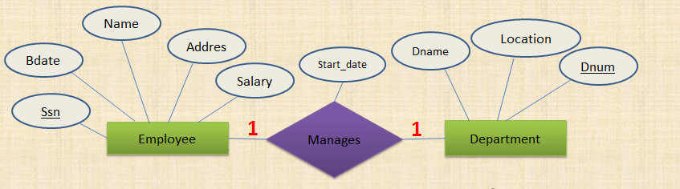
ER to Relational schema (1 to 1 relation)
Employee( Ssn, Bdate, Name, Address, salary)
Department ( Dname, Location, Dnum, Mgr_Ssn, Mgr_start_date)

Slide 9
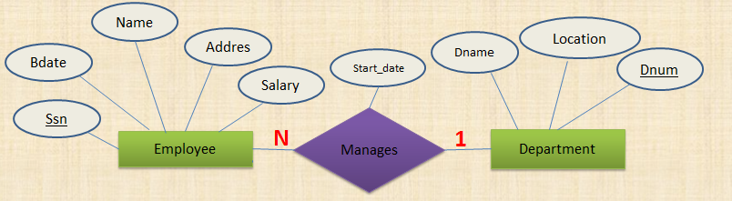
ER to Relational schema (1 to many relation)
Employee( Ssn, Bdate, Name, Address, salary, Dnum )
Department ( Dname, Location, Dnum )

Slide 10
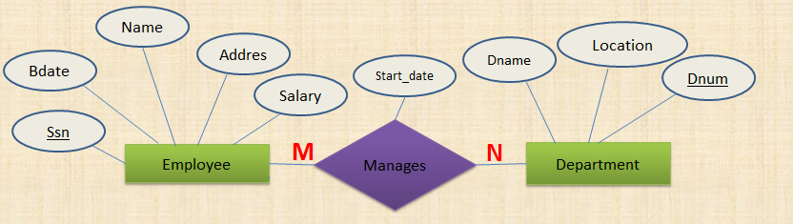
ER to Relational schema (Many to Many relation)
Employee( Ssn, Bdate, Name, Address, salary )
Department( Dname, location, Dnum )
Manages(Ssn, Dnum, Mng_Start_date)

Slide 11
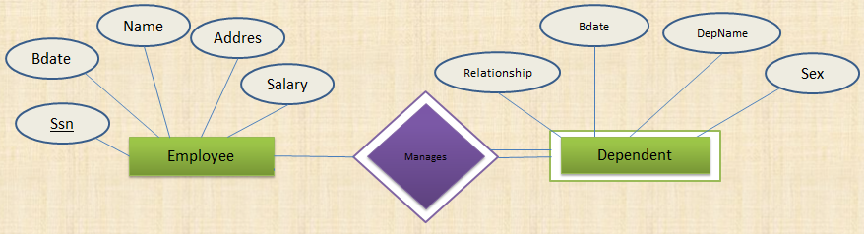
ER to Relational schema (Weak Entity)
Dependent ( Essn, Relatinship, Bdate, Depname, sex )

Slide 12
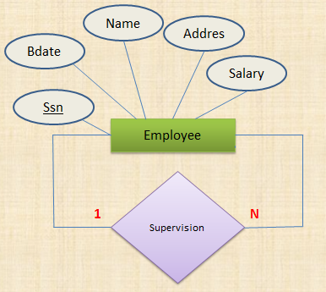
ER to Relational schema (1 to many Unary recursive)
Employee( Ssn, Bdate, Name, Address, salary, Super_Ssn )

Slide 13
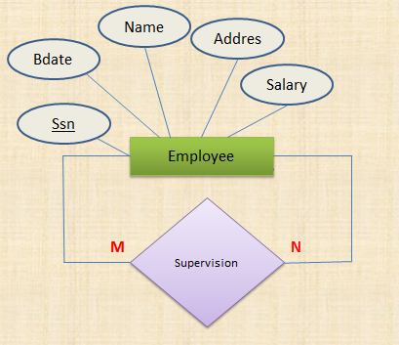
ER to Relational schema (many to many Unary recursive)
Employee( Ssn, Bdate, Name, Address, salary)
Emp_Supervisor( Essn, Super_Ssn )

Slide 14
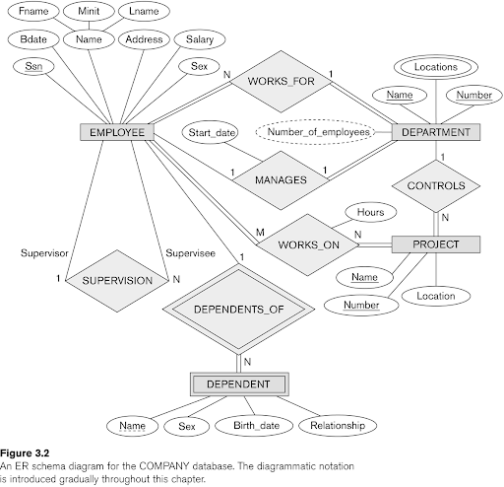
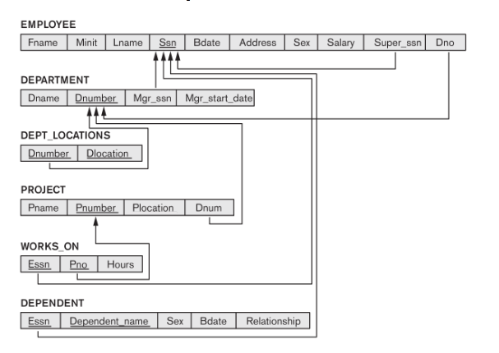

Slide 15
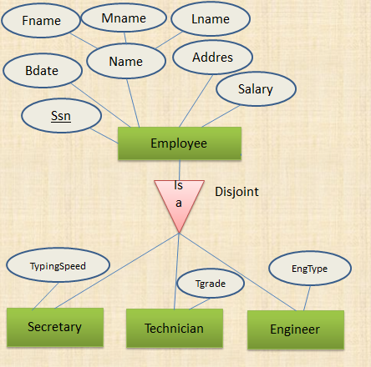
ER to Relational schema (Specialization/Generalization)
Employee ( Ssn, Bdate, Fname, Mname, Lname, Address, salary )
Secretary ( Ssn, TypingSpeed )
Technician ( Ssn, Tgrade )
Engineer (Ssn, EngType)

Slide 16
ER to Relational schema (Specialization/Generalization)
Secretary (Ssn, Bdate, Fname, Mname, Lname, Address, salary, TypingSpeed )
Technician (Ssn, Bdate, Fname, Mname, Lname, Address, salary, Tgrade )
Engineer (Ssn, Bdate, Fname, Mname, Lname, Address, salary, EngType)

Slide 17
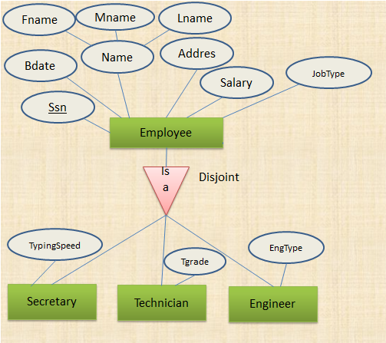
ER to Relational schema (Specialization/Generalization)
Employee ( Ssn, Bdate, Fname, Mname, Lname, Address, salary, JobType, TypingSpeed, Tgread, EngType)

Slide 18
Thank you

